Slide 1
EXPLORATORY DATA ANALYSIS Credit Assignment
UPGRAD & IIITB, DATA SCIENCE DSC65 – FEB 2024
By G b shruthI

Slide 2
Problem Statement
The data given below contains the information about the loan application at the time of applying for the loan. It contains two types of scenarios:
The client with payment difficulties: He/She had late payment more than X days on at least one of the first Y instalments of the loan in our sample.(Target = 1)
All other cases: All other cases when the payment is paid on time. (Target = 0)

Slide 3
STEPS of EDA:
Application Data Analysis
Previous Application Data Analysis
Conclusion

Slide 4
Application data analysis
Import necessary modules
Reading and Analyzing Data
Checking the Null Percentage of values
Imputing the values
Standardization of Data
Identifying the Outliers
Categorical and Numerical Analysis
Univariate Analysis
Bivariate Analysis
Multivariate Analysis

Slide 5
Application data analysis steps
At first, we need to analyze the data of the given excel like checking column headers etc.
Check the shape of the data frame. (307511, 122)
Check the no of null value rows present in each and every column and also its data types using info() function.
Check the statistical information of data frame using describe() function.
First we need to check the percentage of null values of columns and drop the columns with 50% null values as their presence does impact the statistics.
Remaining columns who have less percentage of null values , we will impute the columns with Mean()/Median() – Numerical columns and Mode() – Categorical columns.

Slide 6
Application data analysis steps
Standardize the values of columns like for Time columns if all the values should be converted to either Seconds or Minutes or Hours and if any columns have negative values convert it into positive values.
Irrelevant columns are dropped because they are not meant for analysis if required.
Identify the Outliers using boxplot, if any outliers calculate the IQR for them, calculate the upper bounds and lower bounds.
IQR=Q3-Q1 ;
lower_bound=Q1-1.5*IQR ;
upper_bound=Q3+1.5*IQR
app[col]=np.where(app[col]>upper_bound,upper_bound,app[col])
app[col]=np.where(app[col]<lower_bound,lower_bound,app[col])

Slide 7
Application data analysis steps
Segregate all the columns of data frame based on this data type into Categorical and Numerical Variables for Data Visualization using MatplotLib and seaborn libraries.
Now Univariate Analysis is done on the Categorical variables using BAR Plot and it is also done on the Numerical variables using HIST Plot and their insights are taken accordingly.
Bivariate Analysis is done using SCATTER Plot and BAR plots and their insights are taken.
Multivariate Analysis is done between Continuous Numerical Variables using Heat Maps.

Slide 8
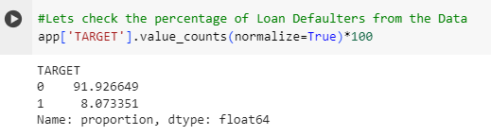
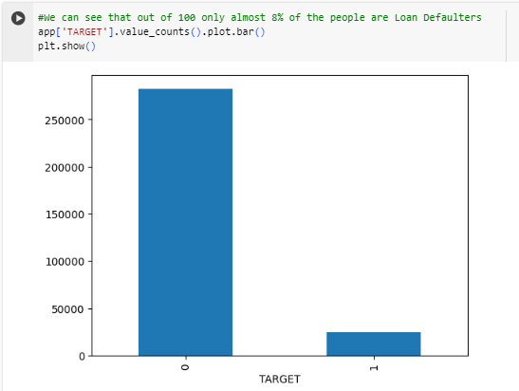
Univariate Analysis
Check the TARGET Variable of Data Frame which the depicts the percentage of Loan Defaulters in Data.
We can see that out of 100 only almost 8% of the
people are Loan Defaulters from our given Data in
Application File.

Slide 9
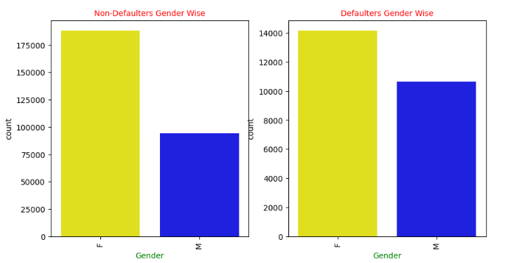
CODE_GENDER
INSIGHTS:
1.Firstly, Among Non-Defaulters, i.e., TARGET == 0, Females are in higher number than males. 2.Next, Among Defaulters, i.e., TARGET == 1, Here also the Females are in higher number than males.

Slide 10
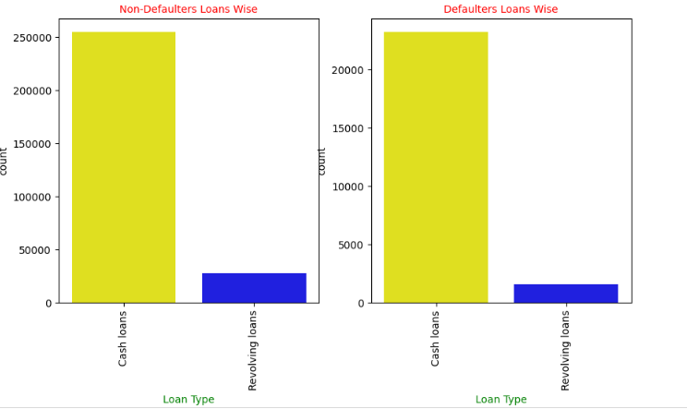
NAME_CONTRACT_TYPE
INSIGHTS:
1. Firstly, Among Non-Defaulters, i.e., TARGET == 0, Cash loans are in higher number than Revolving loans. 2. Next, Among Defaulters, i.e., TARGET == 1, Here also the Cash loans are in higher number than Revolving loans.

Slide 11
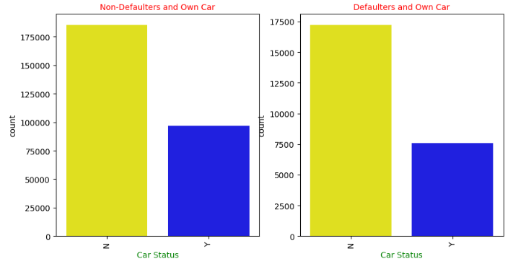
FLAG_OWN_CAR
INSIGHTS:
1.Firstly, Among Non-Defaulters, i.e., TARGET == 0, Maximum of them are not having a own car with them. 2.Next, Among Defaulters, i.e., TARGET == 1, Here also Maximum of them are not having a own car with them.

Slide 12
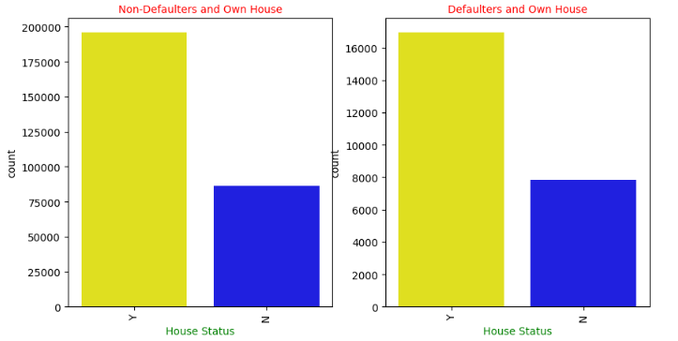
FLAG_OWN_REALTY
INSIGHTS:
1.Firstly, Among Non-Defaulters, i.e., TARGET == 0, Maximum of them are having a own house with them. 2.Next, Among Defaulters, i.e., TARGET == 1, Here also Maximum of them are having a own house with them.

Slide 13
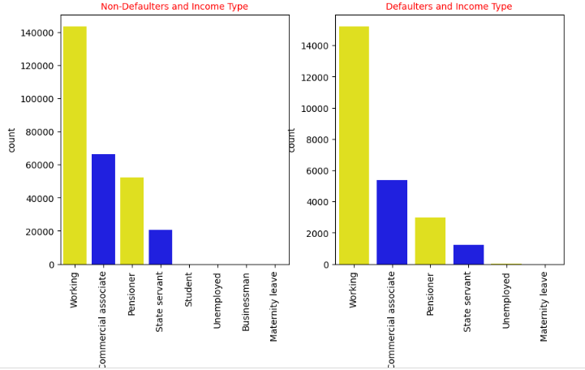
NAME_INCOME_TYPE
INSIGHTS:
1.Firstly, Among Non-Defaulters, i.e., TARGET == 0, Working professionals are maximum followed by commercial associates. 2.Next, Among Defaulters, i.e., TARGET == 1, Here also Working professionals are maximum followed by commercial associates.

Slide 14
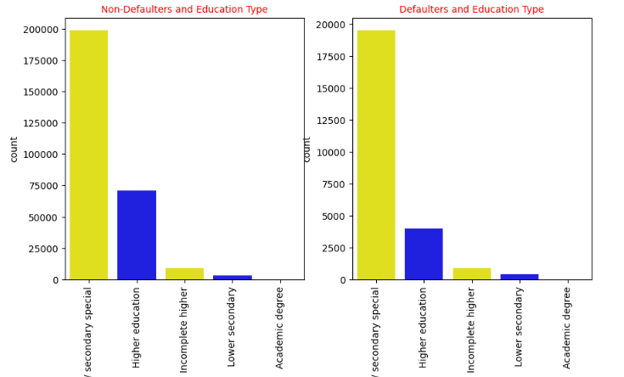
NAME_EDUCATION_TYPE
INSIGHTS:
1.Firstly, Among Non-Defaulters, i.e., TARGET == 0, Most of them are secondary education followed by higher education. 2.Next, Among Defaulters, i.e., TARGET == 1, Here also Most of them are secondary education followed by higher education.

Slide 15
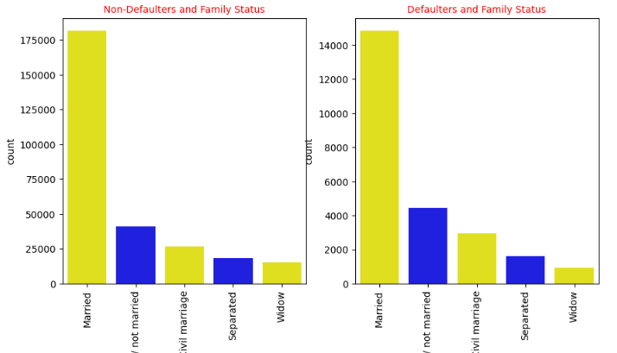
NAME_FAMILY_STATUS
INSIGHTS:
1.Firstly, Among Non-Defaulters, i.e., TARGET == 0, Most of them are Married. 2.Next, Among Defaulters, i.e., TARGET == 1, Here also Most of them are Married.

Slide 16
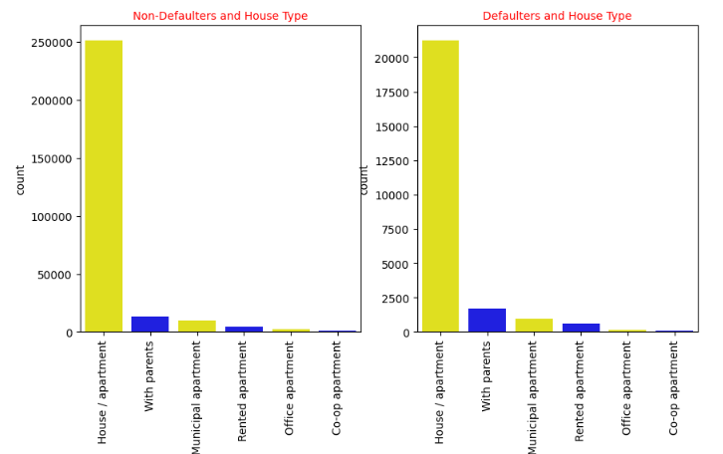
NAME_HOUSING_TYPE
INSIGHTS:
1.Firstly, Among Non-Defaulters, i.e., TARGET == 0, Most of them are living in House/Apartment. 2.Next, Among Defaulters, i.e., TARGET == 1, Here also Most of them are living in House/Apartment.

Slide 17
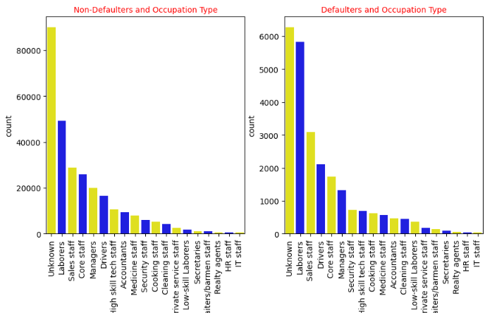
OCCUPATION_TYPE
INSIGHTS:
1.Firstly, Among Non-Defaulters, i.e., TARGET == 0, Most of them are Labourers apart from Unknown occupation type. 2.Next, Among Defaulters, i.e., TARGET == 1, Here also Most of them are Labourers apart from Unknown occupation type.

Slide 18
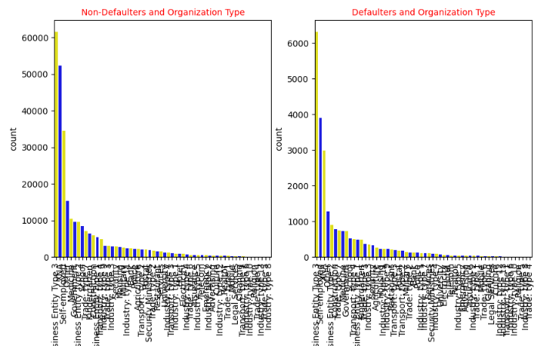
ORGANIZATION_TYPE
INSIGHTS:
1.Firstly, Among Non-Defaulters, i.e., TARGET == 0, Most of them belongs to Business Entity Type3. 2.Next, Among Defaulters, i.e., TARGET == 1, Here also belongs to Business Entity Type3.

Slide 19
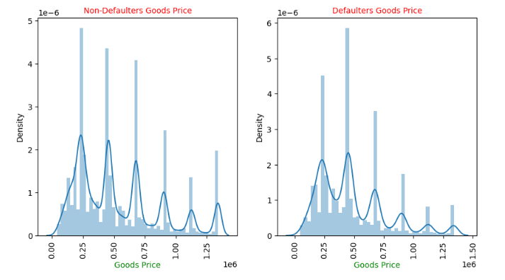
AMT_GOODS_PRICE
INSIGHTS:
1.Firstly, Among Non-Defaulters, i.e., TARGET == 0, Most of the goods price falls under 0.2 to 0.5. 2.Next, Among Defaulters, i.e., TARGET == 1, Here also Most of the goods price falls under 0.2 to 0.5.

Slide 20
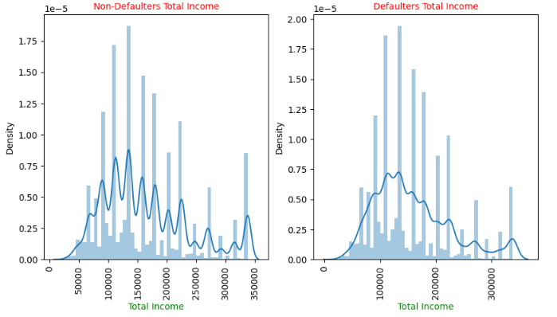
AMT_INCOME_TOTAL
INSIGHTS:
1.Firstly, Among Non-Defaulters, i.e., TARGET == 0, Most of them earn from 1Lakh to 1.5 Lakh 2.Next, Among Defaulters, i.e., TARGET == 1, Here also Most of them earn from 1Lakh to 1.5 Lakh

Slide 21
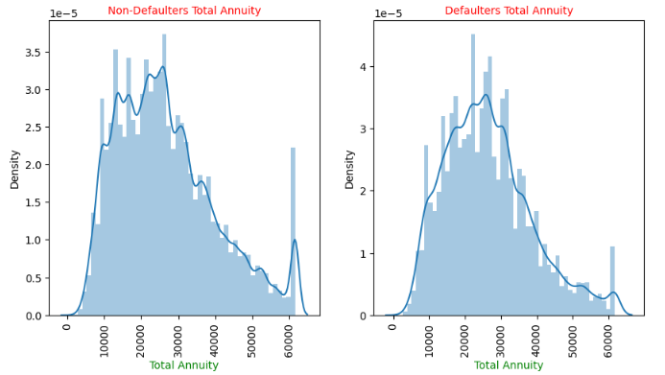
AMT_ANNUITY
INSIGHTS:
1.Firstly, Among Non-Defaulters, i.e., TARGET == 0, total annuity lies from 20k to 30k. 2.Next, Among Defaulters, i.e., TARGET == 1, Here also total annuity lies from 20k to 30k.

Slide 22
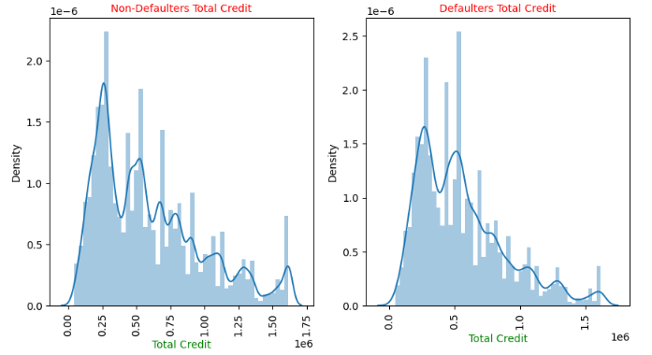
AMT_CREDIT
INSIGHTS:
We can see that the lesser the credit amount of the loan, the more chances of being a defaulter.

Slide 23
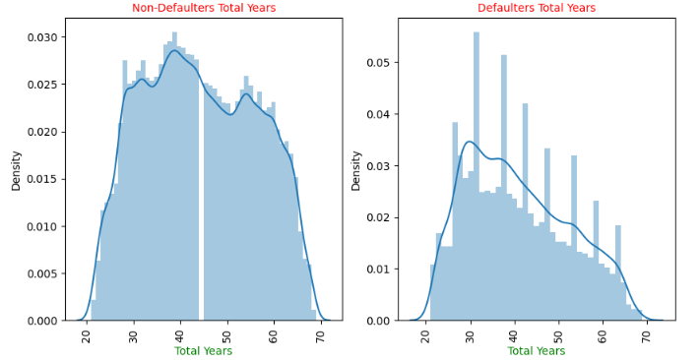
YEARS
INSIGHTS:
1.Firstly, Among Non-Defaulters, i.e., TARGET == 0, total age lies from 30-40. 2.Next, Among Defaulters, i.e., TARGET == 1, Here also total age lies from 30-40.

Slide 24
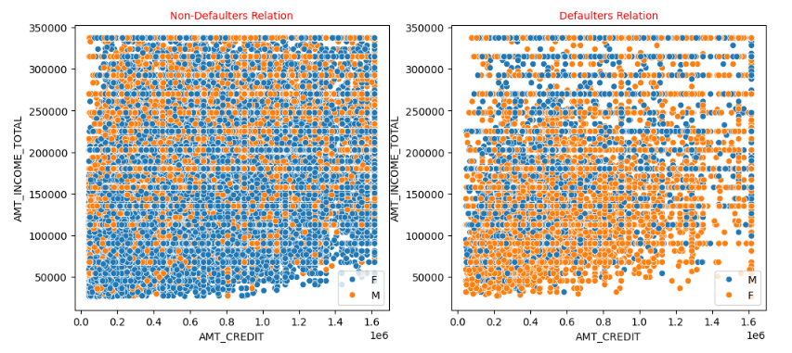
BIVARIATE ANALYSIS
AMT_CREDIT and AMT_INCOME_TOTAL Grouped by CODE_GENDER
INSIGHTS:
1.Firstly, Among Non-Defaulters, i.e., TARGET == 0, Female and males are in same ratio. 2.Next, Among Defaulters, i.e., TARGET == 1, Here also Female and males are in same ratio in the initial stage of complete graph.

Slide 25
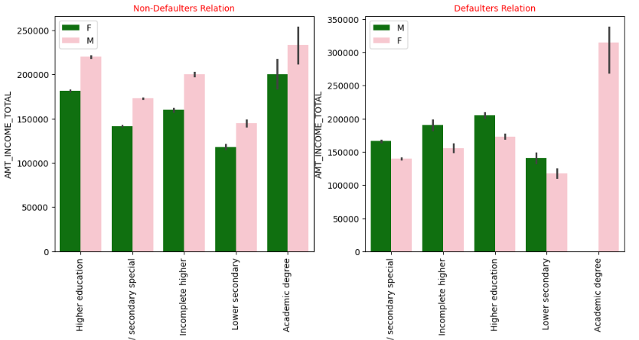
EDUCATION_TYPE and AMT_INCOME_TOTAL Grouped by CODE_GENDER
INSIGHTS:
1.Firstly, Among Non-Defaulters, i.e., TARGET == 0, Female in all educational aspects are more non-defaulters than male. 2.Next, Among Defaulters, i.e., TARGET == 1, Here also we can see that males are earning more as well being the more defaulters.

Slide 26
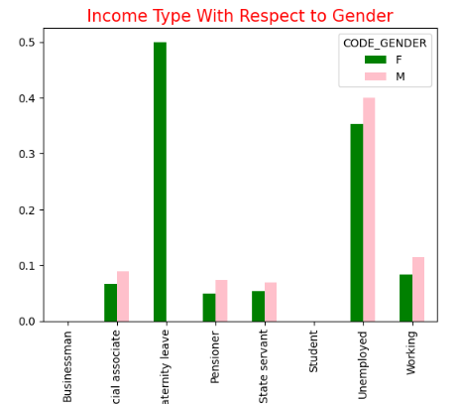
AMT_INCOME_TYPE and CODE_GENDER
INSIGHTS:
1.We can see that Unemployed people are more defaulters in both male and female case. 2.Males are more unemployed than female. 3.Maternity leave females are also in higher no in defaulters list. 4.Male number’s are more compare to female in defaulters list.

Slide 27
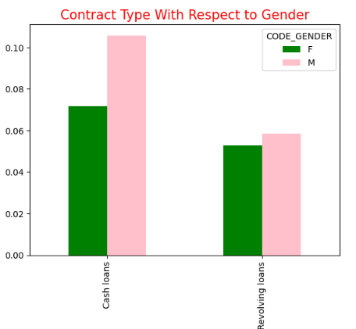
NAME_CONTRACT_TYPE and CODE_GENDER
INSIGHTS:
1. For Cash loans, males are more in number than females and similarly with Revolving loans.

Slide 28
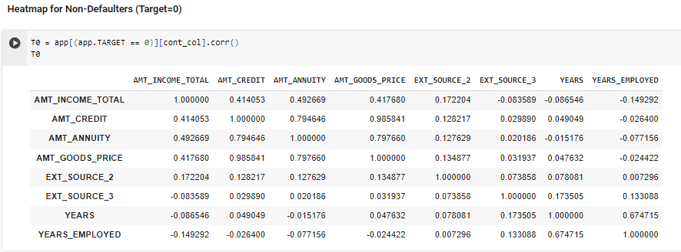
MULTI-VARIATE ANALYSIS
Continuous columns = ['AMT_INCOME_TOTAL','AMT_CREDIT','AMT_ANNUITY',
'AMT_GOODS_PRICE','EXT_SOURCE_2','EXT_SOURCE_3','YEARS','YEARS_EMPLOYED']
Heat Maps are plotted against the continuous numerical variables for Non-Defaulters

Slide 29
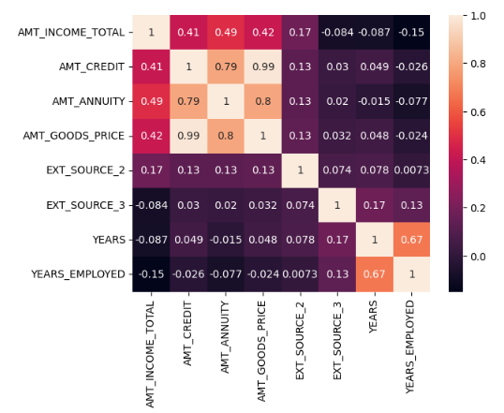
INSIGHTS:
The more the correlated percentage means the high value for being a Non-defaulter. * 0.99% = AMT_CREDIT & AMT_GOODS_PRICE.
* 0.79% = AMT_CREDIT & AMT_ANNUITY.
* 0.80% = AMT_GOODS_PRICE & AMT_ANNUITY.
* 0.67% = Age & DAYS_EMPLOYED

Slide 30
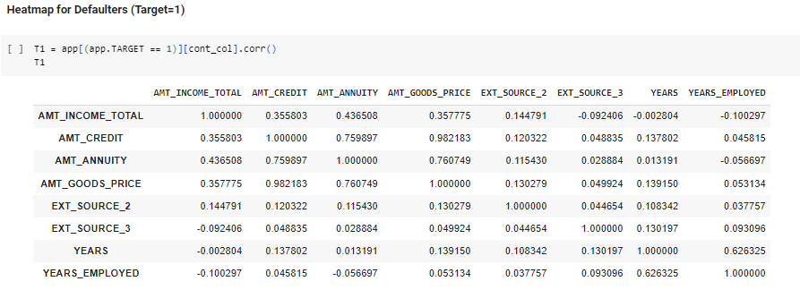
Continuous columns = ['AMT_INCOME_TOTAL','AMT_CREDIT','AMT_ANNUITY',
'AMT_GOODS_PRICE','EXT_SOURCE_2','EXT_SOURCE_3','YEARS','YEARS_EMPLOYED']
Heat Maps are plotted against the continuous numerical variables for Defaulters

Slide 31
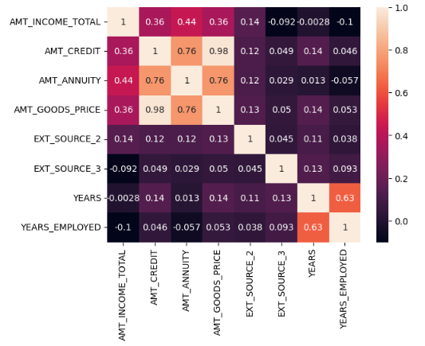
INSIGHTS:
The more the correlated percentage means the high value for being a defaulter.
* 0.98% = AMT_CREDIT & AMT_GOODS_PRICE
* 0.76% = AMT_CREDIT & AMT_ANNUITY
* 0.76% = AMT_GOODS_PRICE & AMT_ANNUITY
* 0.58% = YEARS & DAYS_EMPLOYED

Slide 32
Previous Application Data Analysis
Import necessary Modules
Reading and Analyzing Data
Checking the Null Percentage of values
Imputing the values
Standardization of Data
Identifying the Outliers
Merging the 2 Data Frames
Univariate Analysis
Bivariate and Multivariate Analysis

Slide 33
Previous Application Data Analysis steps
Same like Application Data Analysis, analyze the data of the given excel like checking column headers.
Check the shape of the data frame. (1670214, 37)
Check the no of null value rows present in each and every column and also its data types using info() function and for statistical information of data frame using describe() function.
First we need to check the percentage of null values of columns and drop the columns with 50% null values as their presence does impact the statistics.
Remaining columns who have less percentage of null values , we will impute the columns with Mean()/Median() – Numerical columns and Mode() – Categorical columns.
Standardize the values of columns like for Time columns if all the values should be converted to either Seconds or Minutes or Hours and if any columns have negative values convert it into positive values.

Slide 34
Previous Application Data Analysis steps
Identify the Outliers using boxplot, if any outliers calculate the IQR for them, calculate the upper bounds and lower bounds.
Merge the Application data Frame and Previous Application data Frame together on SK_ID_CURR and draw the insights from the combined data frame.
Segregate all the columns of combined data frame based on this data type into Categorical and Numerical Variables for Data Visualization using MatplotLib and seaborn libraries.
Now Univariate Analysis is done on the Categorical variables using BAR Plot and it is also done on the Numerical variables using DIST Plot and their insights are taken accordingly.
Bivariate Analysis is done using Count Plot and Dist plots and their insights are taken.
Multivariate Analysis is done between Continuous Numerical Variables using Heat Maps.

Slide 35
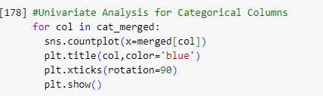
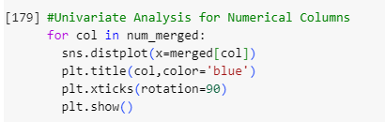
UNIVARIATE ANALYSIS
Univariate Analysis is done for Categorical columns
using Count Plot.
Univariate Analysis is done for Numerical columns
using Dist Plot.

Slide 36
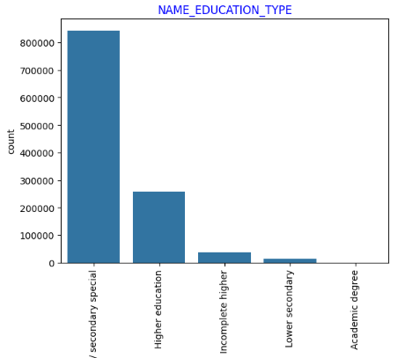
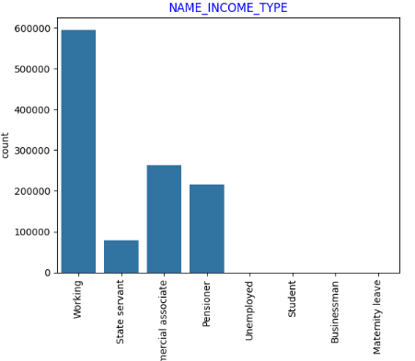
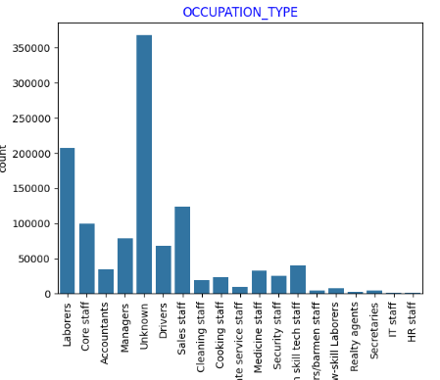
NAME_EDUCATION_TYPE
NAME_INCOME_TYPE
OCCUPATION_TYPE

Slide 37
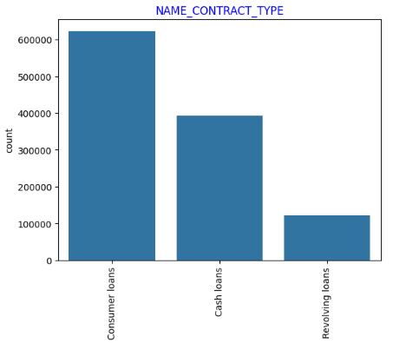
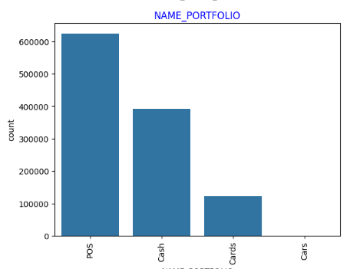
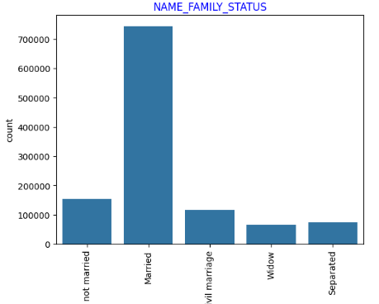
NAME_CONTRACT_TYPE
NAME_PORTFOLIO
NAME_FAMILY_STATUS

Slide 38
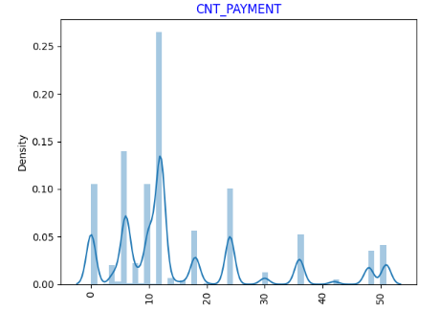
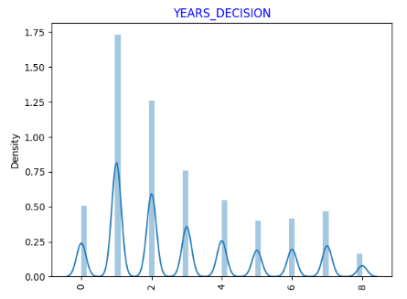
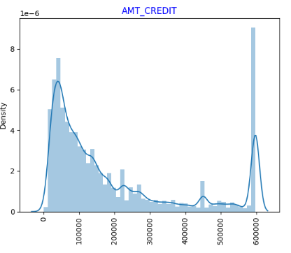
CNT_PAYMENT
YEARS_DECISION
AMT_CREDIT

Slide 39
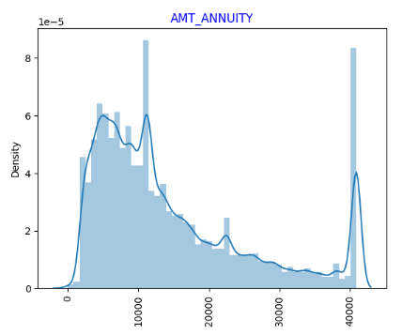
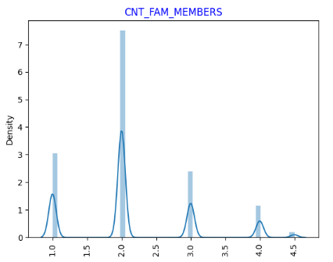
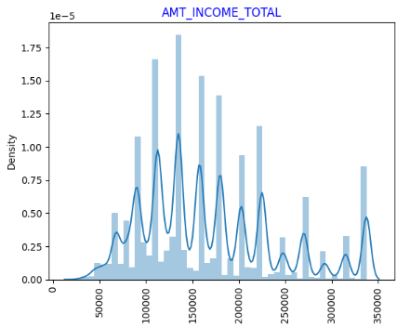
AMT_ANNUITY
CNT_FAM_MEMBERS
AMT_INCOME_TOTAL

Slide 40
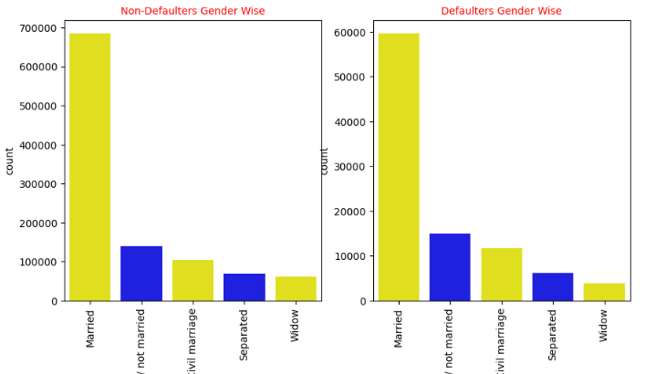
TARGET and CODE_GENDER
INSIGHTS:
1. For Cash loans, males are more in number than females and similarly with Revolving loans.

Slide 41
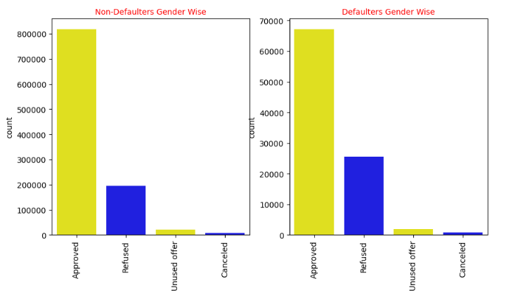
TARGET and CODE_GENDER
INSIGHTS:
1. Among Defaulters and Non-Defaulters, Approved loans are of high percentage.

Slide 42
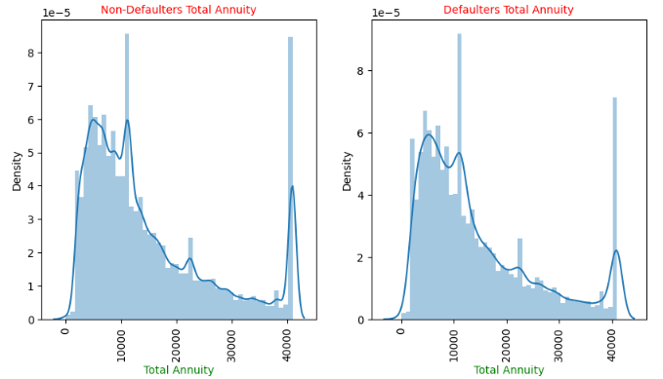
TARGET and AMT_ANNUITY
INSIGHTS:
1. Among Defaulters and Non-Defaulters, Total Annuity is more in between 5000 to 15000.

Slide 43
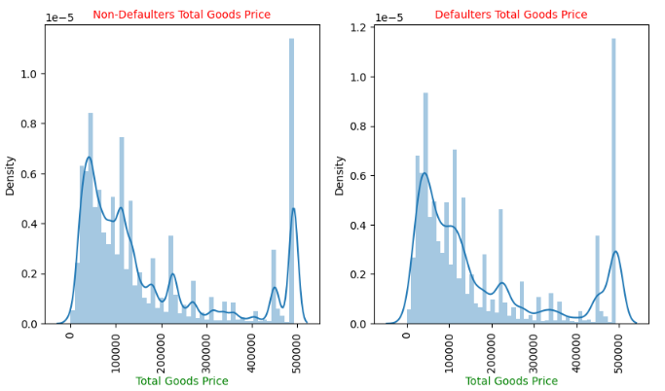
TARGET and AMT_TOTAL_CREDIT
INSIGHTS:
1. Among Defaulters and Non-Defaulters, Total Goods Price is between 5000 to 10000.

Slide 44
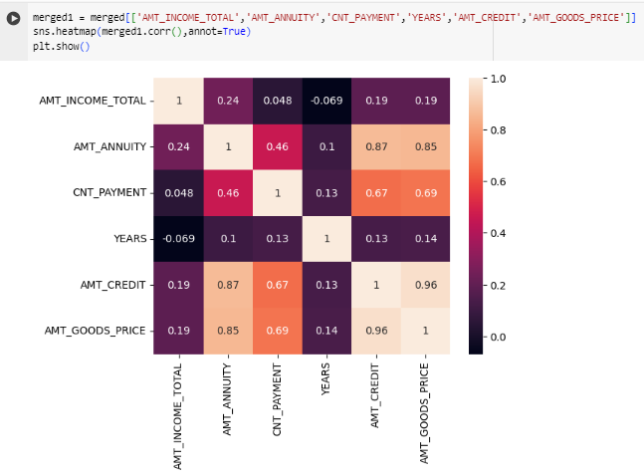
BIVARIATE ANALYSIS
INSIGHTS:
* 0.96% = AMT_CREDIT & AMT_GOODS_PRICE.
* 0.87% = AMT_CREDIT & AMT_ANNUITY.
* 0.85% = AMT_GOODS_PRICE & AMT_ANNUITY.

Slide 45
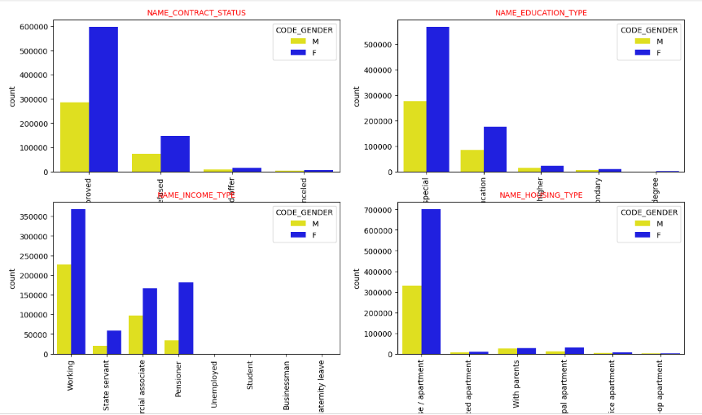
CODE_GENDER is Combined with NAME_CONTRACT_STATUS, NAME_EDUCATION_TYPE,
NAME_INCOME_TYPE and NAME_HOUSING_TYPE
INSIGHTS:
Every where the females are high in number than males.

Slide 46
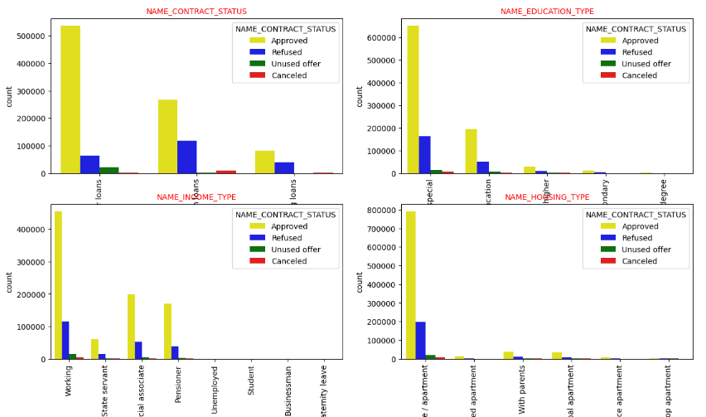
NAME_CONTRACT_STATUS is Combined with NAME_CONTRACT_STATUS, NAME_EDUCATION_TYPE,
NAME_INCOME_TYPE and NAME_HOUSING_TYPE
INSIGHTS:
Every where the no of loans approved is higher.

Slide 47
CONCLUSION FOR DEFAULTERS
People with Lower Secondary / Secondary education are likely to be Defaulters followed by higher education.
The percentage of Cash Loans are higher than Revolving Loans that too males are greater in number.
Maximum Defaulters don't have an own car.
Maximum Defaulters of them do have an own house and it is either a house or apartment.
Most of the Defaulters are working professionals followed by Commercials.
Most of the Defaulters are Married.
Defaulters comes under the age of 30-40 years.
We can see that the lesser the credit amount of the loan, the more chances of being a defaulter.
Total annuity lies from 20k to 30k.

Slide 48
CONCLUSION FOR DEFAULTERS
Business Entity type 3 from Organization Type comes under Defaulters at a maximum rate.
Males ratio is at relatively higher default rate than Females.
We can see that males are earning more as well being the more defaulters.
We can see that Unemployed people are more defaulters in both male and female case.
Males are more unemployed than females.
Maternity leave females are also in higher number in defaulters list.
Male nos are more when compared with female in defaulters list.

Slide 49
CONCLUSION FOR NON-DEFAULTERS
Rating with 1 in REGION_RATING_CLIENT column comes under Non-Defaulters.
Student and Businessmen have no defaults.
People above age of 50 have high probability of Non-Defaulters.
Females are more in number for Non-Defaulters.
The percentage of Cash Loans are higher than Revolving Loans that too males are greater in number.
Maximum Non-Defaulters don't have an own car.
Maximum Non-Defaulters of them do have an own house and it is either a house or apartment.

Slide 50
THANK YOU

